Slide 1
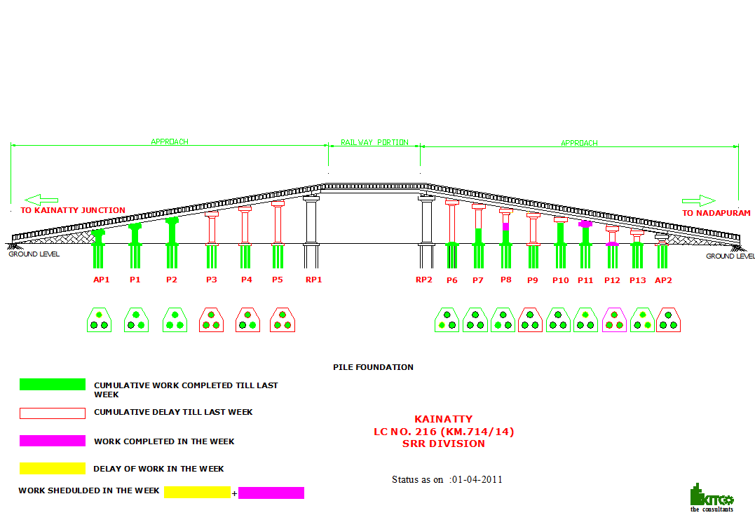
ROB at Kainatti Progress as on 01/04/11

